Slide 1
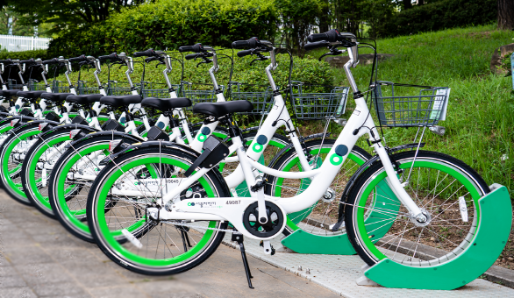
Regression Modeling on Bike Sharing Data Set
T. Sai Harish Sarma

Slide 2
Content
Business Context
Problem Statement
Data Cleaning & EDA
Feature Engineering
Pre Processing Data
Target Conditioning
Modelling, Evaluation & Tuning
Model Explainability &Conclusion

Slide 3
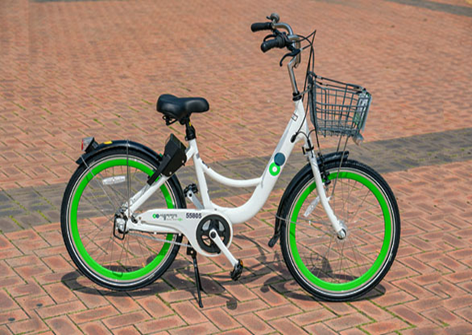
Business Context
Seoul is the official capital city of South Korea.
Seoul Metropolitan Government provides Rental Bike Service to the public.
These Public Bikes are designed to be used by all women, the elderly and the infirm.
These Bikes are made light weight and durable.

Slide 4
Problem Statement
Currently Rental bikes are introduced in many urban cities for the enhancement of mobility comfort. It is important to make the rental bike available and accessible to the public at the right time as it lessens the waiting time. Eventually, providing the city with a stable supply of rental bikes becomes a major concern. The crucial part is the prediction of bike count required at each hour for the stable supply of rental bikes.

Slide 5
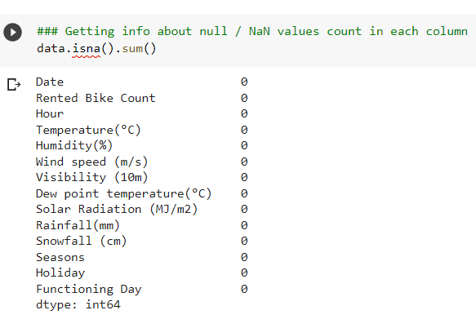
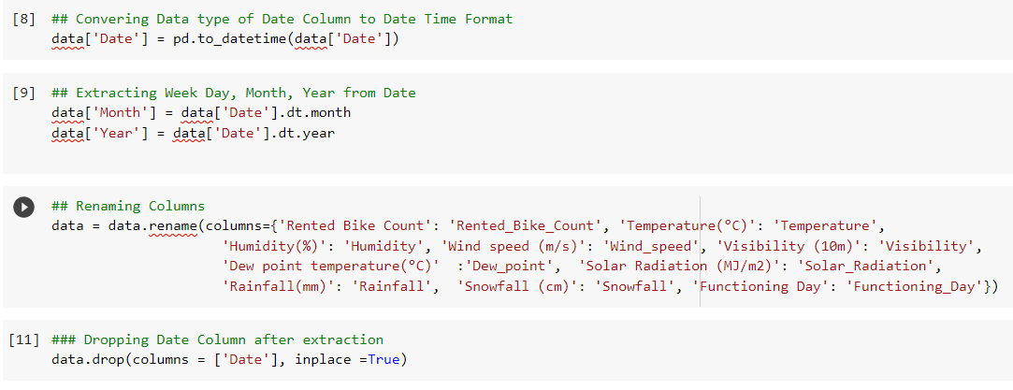
Data Cleaning

Slide 6
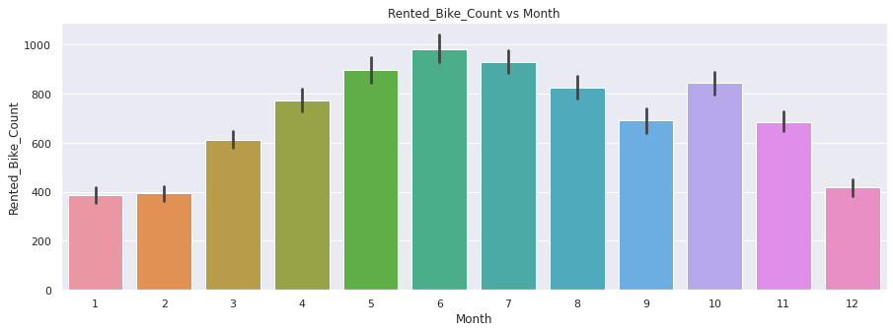
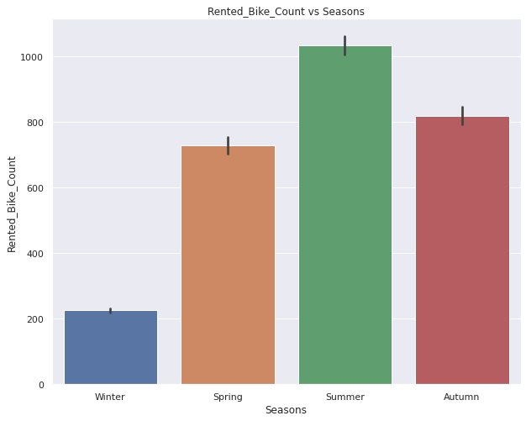
Exploratory Data Analysis

Slide 7
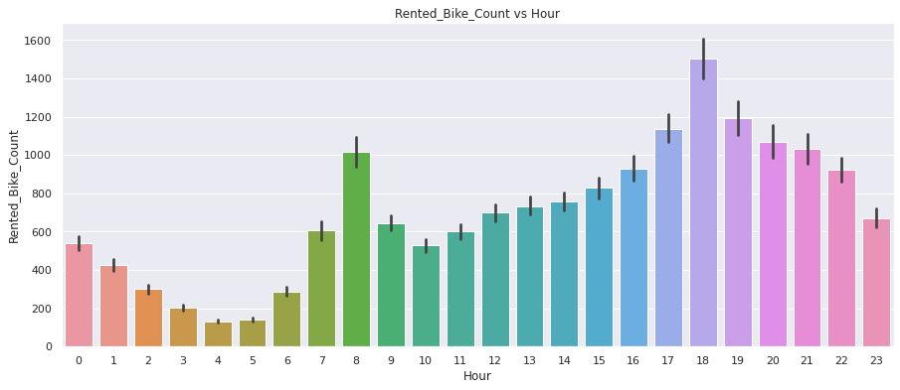
Exploratory Data Analysis

Slide 8
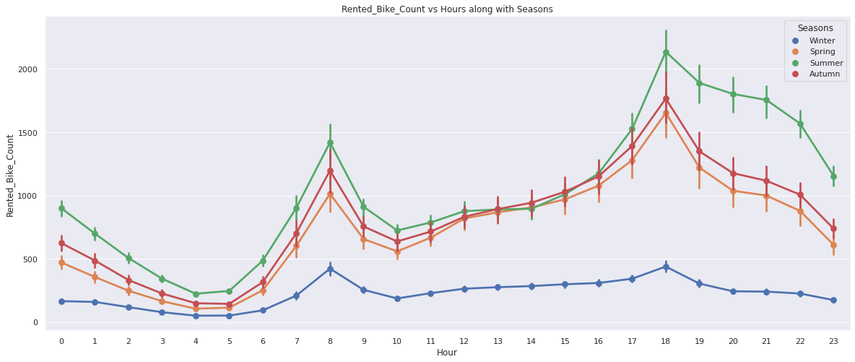
Exploratory Data Analysis

Slide 9
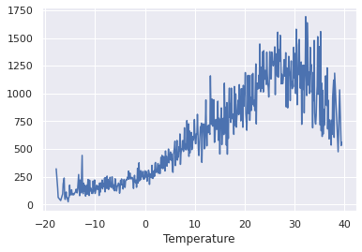
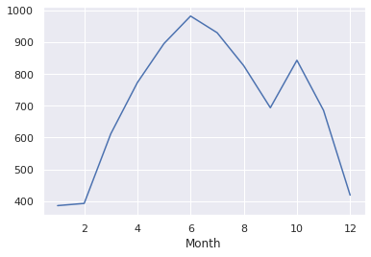
Exploratory Data Analysis

Slide 10
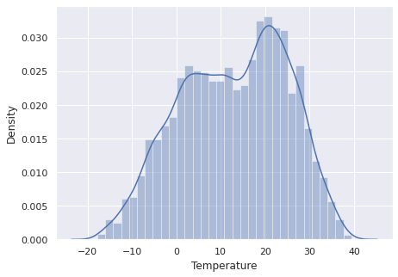
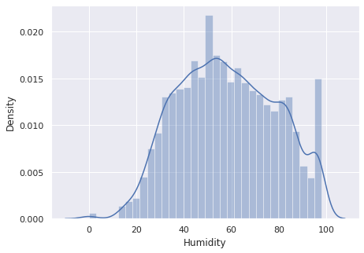
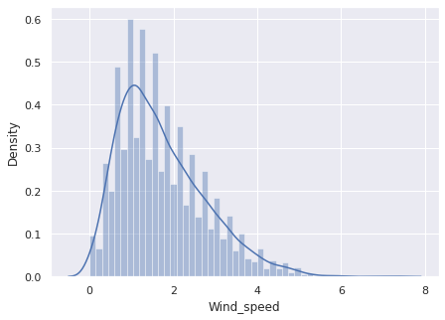
Exploratory Data Analysis

Slide 11
Feature Engineering
Feature Encoding
Correlation Check
Outlier Treatment
Multicollinearity Check
Linearity Check

Slide 12
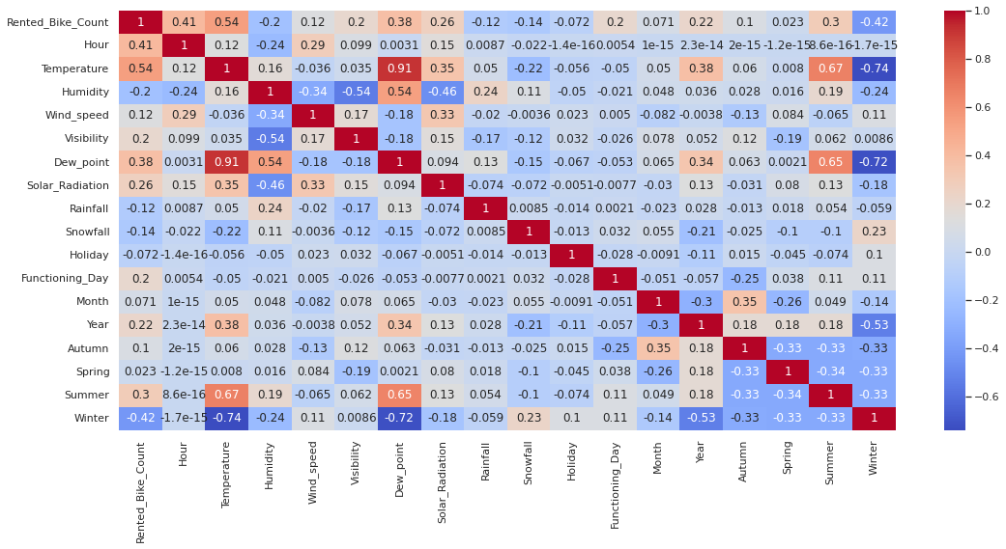
Feature Engineering – Correlation

Slide 13
Feature Engineering – Correlation
Positive Correlation:
Temperature
Dew Point Temperature
Solar Radiation
Negative correlation:
Winter
Humidity
Snowfall
The feature Dew Point Temperature is positively and highly correlated with Temperature.
There will be no effect in our model if Dew Point Temp. variable is removed.

Slide 14
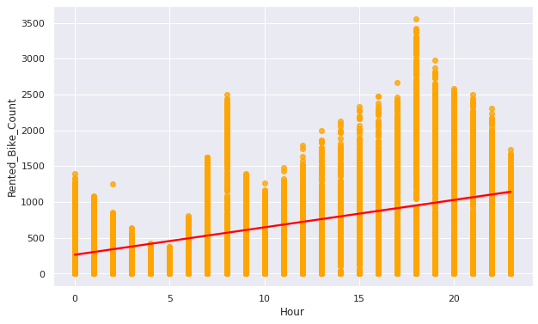
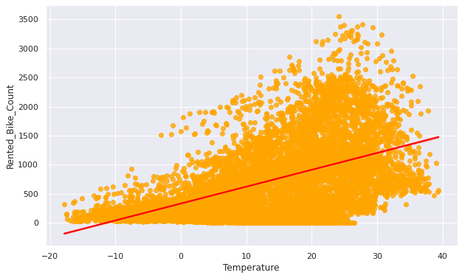
Linearity Check

Slide 15
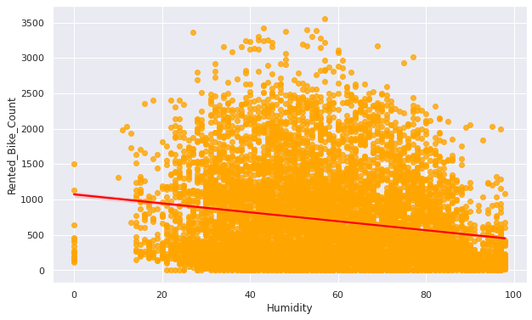
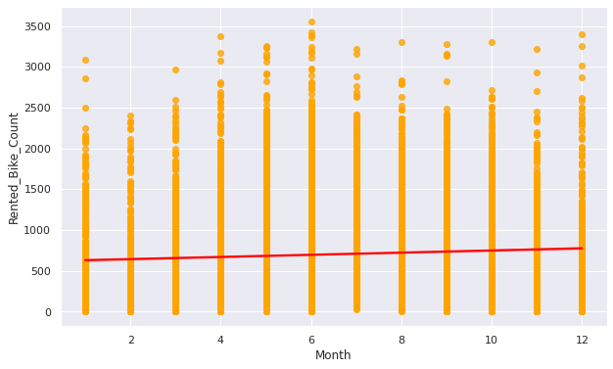
Linearity Check

Slide 16
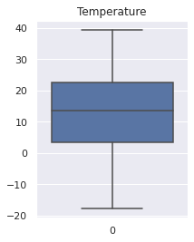
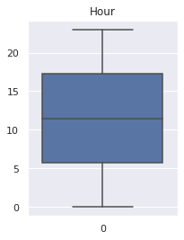
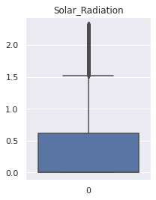
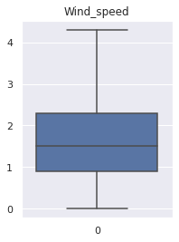
Pre Processing Data - Outliers

Slide 17
Outlier Treatment
Q1 – 25% & Q3 – 75%
IQR =Q3-Q1
u_lim= Q3+ 1.5*(IQR)
l_lim= Q1- 1.5*(IQR)

Slide 18
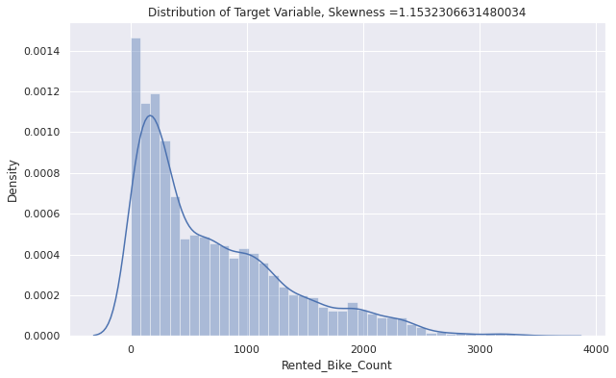
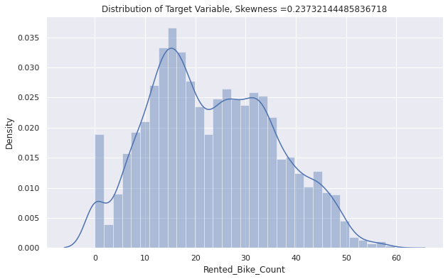
Target Feature Conditioning

Slide 19
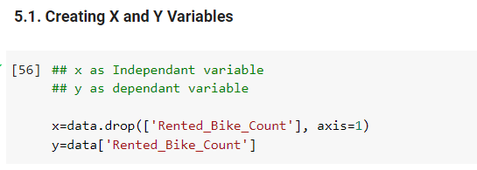
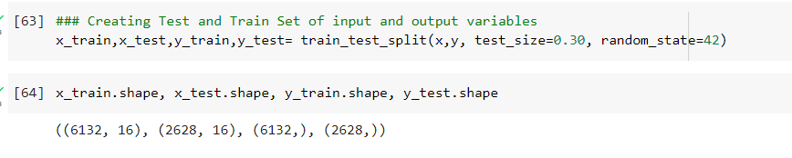
Creating Input and Out Features

Slide 20
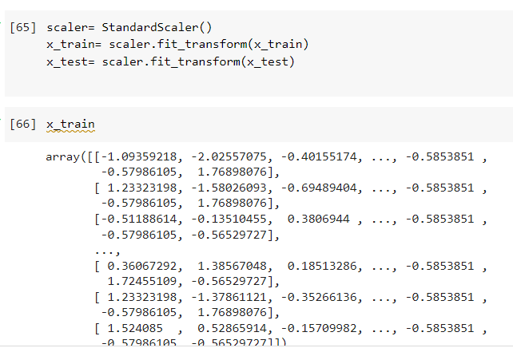
Feature Scaling

Slide 21
Modeling, Evaluating & Tuning
Linear Regression
Lasso Regression with GridSearchCV
Ridge Regression with GridSearchCV
Random Forest with GridSearchCV
Gradient Boosting Regressor with GridSearchCV

Slide 22
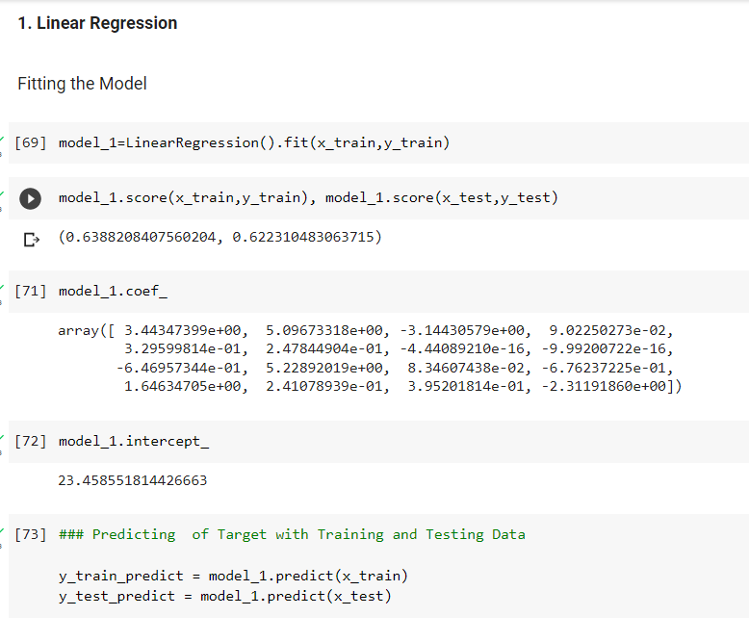
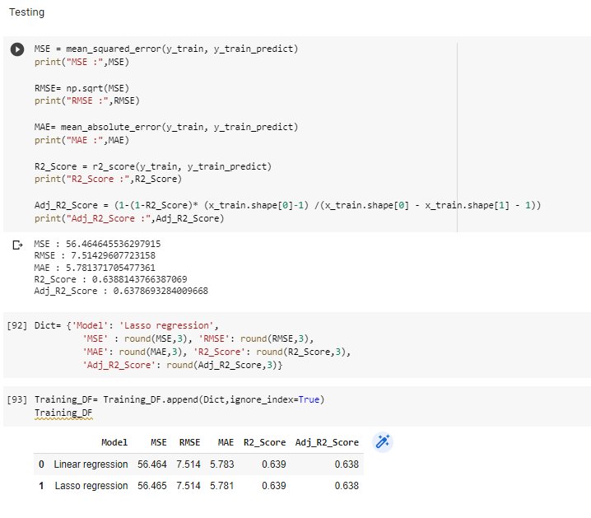

Slide 23
Modeling, Evaluating & Tuning
Evaluation Metrics:
MSE
MAE
RMSE
R2 SCORE
ADJUSTED R2 SCORE

Slide 24
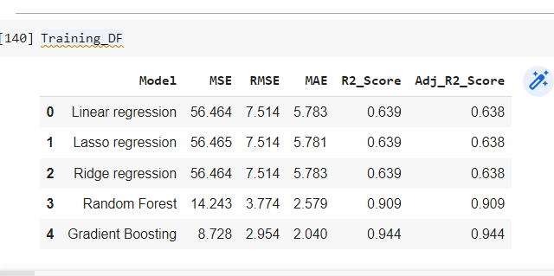
Modeling, Evaluating & Tuning

Slide 25
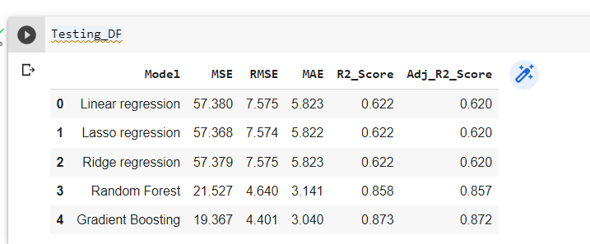
Modeling, Evaluating & Tuning

Slide 26
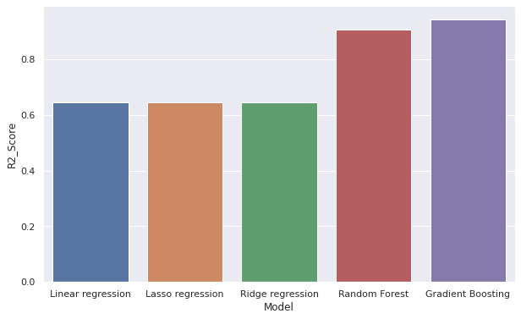
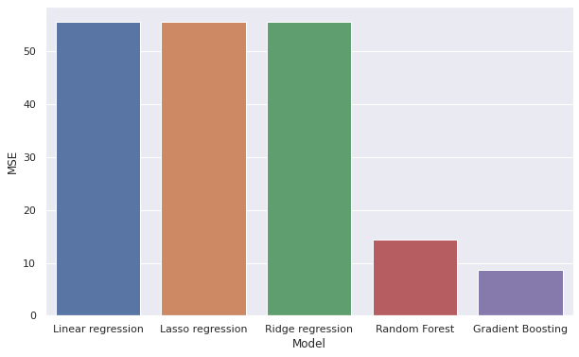
Comparing Models - Training

Slide 27
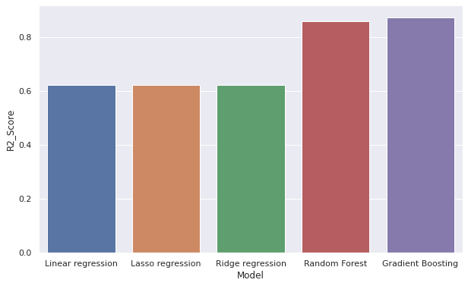
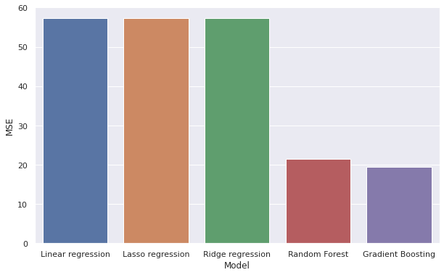
Comparing Models - Testing

Slide 28
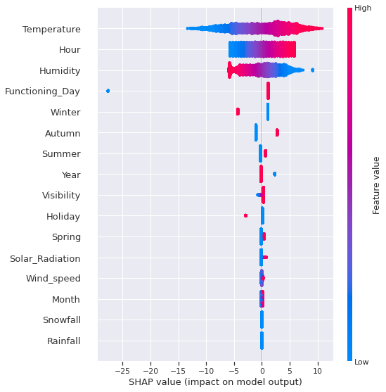
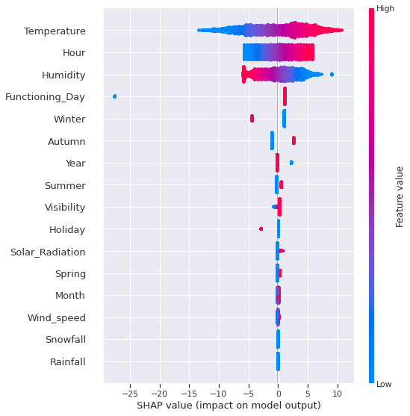
Model Explainability
Linear Regression
Lasso Regression

Slide 29

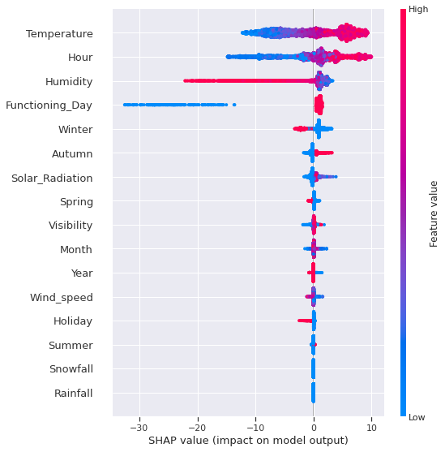
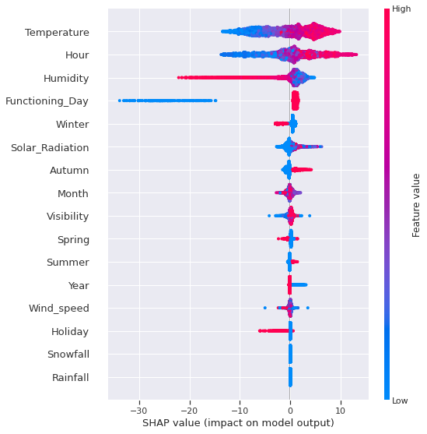
Model Explainability
Ridge Regression
Random Forest Regression
Gradient Boost Regression

Slide 30
Conclusions
1. EDA Outcomes
* The use of bikes is high in between the months of MAY and OCTOBER.
* The bikes are using while reaching and leaving office hours.
* The count of rental bikes is high in summer, Demand is very low in Winter.
* The use of bikes is high, when the temperature ranges between 25 and 30 degrees.
2. Data Quality Issues
* Outliers available, they are removed.
* Multicollinearity
* Correlation
* Feature Encoding

Slide 31
Conclusions
3. Model Outcomes * Among all models, Random Forest and Gradient Boosting are worked better.
* Temperature, Humidity, Hour and Functionalday are the most influencing features on Count of Rental Bikes.
* Linear, Lasso and Ridge Models giving poor results as they are giving r2_score of 0.622, where as the Random forest and Gradient Boosting models giving as 0.858 and 0.873 respectively.
* Ensemble Modeling is preferred as the Mean Squared Error is drastically decreased with Random Forest and Gradient Boosting Regressor.

Slide 32
Thankyou

